Slide 1
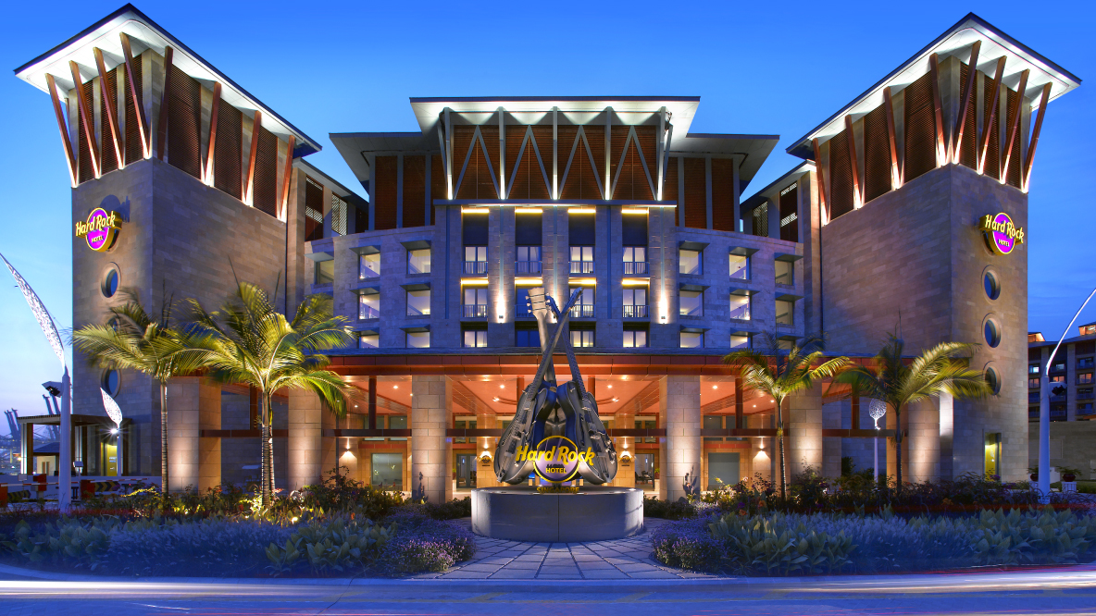
MHM Micro Hotel Management

Slide 2
TABLE OF CONTENTS
Architecture
Technology Stack
Business
Features
Architecture
Technology Stack
Business
Features
Main Scenario

Slide 3
Architecture
Technology Stack
Business
Features
Architecture
Business
Technology Stack
Main Scenario
Reflections

Slide 4
Deployment with CICD

Slide 5
Service communication

Slide 6
Architecture
Technology Stack
Business
Features

Slide 7
CICD

Slide 8
Database
MongoDB and MongoDB Cluster
Messaging
RabbitMQ
Caching
Redis
Security
Spring Security
JWT (Json Web Token)

Slide 9
Build and Deployment
GitHub
Docker
Docker Hub
Kubernetes
Jenkins
Helm
Proxy
Nginx

Slide 10
Services
Netty
Spring Boot
Spring Cloud
Spring Data
Spring Data MongoDB Reactive
Spring Web Flux
WebSocket
JavaScript
Python
Testing and Others
JUNIT
Swagger

Slide 11
Architecture
Technology Stack
Business
Features

Slide 12
Rooms
Room types: Studio, single, double, triple, quad, suite.
Base prices (respectively): 60$, 75$, 90$, 105$, 120$, 150$
Smoking/No smoking 100$ fee
Parking/No parking 10$ fee

Slide 13
Reservation Rules
Reservations shouldn’t exceed a month!
Reservation intervals should belong to same year.

Slide 14
Architecture
Technology Stack
Business
Features

Slide 15
Happy End!
Thank you all for your time and attention.

